Slide 1

Title : Educational Framework for Cognitive Skill Development
Student Name : I.Harshika
Student ID: 2520030607
Cluster : 2
Section: 7
Under the Guidance
of
Supervisor Name: P.Swetha Nagasri
Assistant Professor
Department of CSE

Slide 2
Abstract
BrainBloom is an educational web application designed to enhance cognitive skill development among students from classes 6 to 10.
The framework is based on the idea that every student has a basic level of intelligence, but many students need structured practice to improve their thinking abilities.
The system begins by collecting user information such as name, email, phone number, and class and then adjusts the difficulty level of activities accordingly.
BrainBloom provides an interactive learning environment through gamified activities that encourage students to practice cognitive skills regularly.

Slide 3
The framework integrates six structured cognitive games, each focusing on a specific
skill:
1.LogicLens – logical reasoning and pattern recognition
2.MathSprint – mental arithmetic and numerical ability
3.WordRush – vocabulary and language development
4.RecallRush – memory and attention improvement
5.DecisionDash – decision-making ability
6.SpeedSolve – fast problem-solving skills
Student performance is evaluated using an IQ-based scoring system.
Based on performance, learners are categorized into five levels: Foundation, Improving, Proficient, Advanced, and Excellent.
This level-based evaluation helps students track their progress and continuously
improve their cognitive abilities through consistent practice.

Slide 4
Existing System
Traditional education systems mainly rely on textbook-based learning and
classroom lectures.
Students often have limited opportunities to develop cognitive skills such as logical reasoning, memory, decision-making, and problem solving.
Most learning methods focus on theoretical knowledge rather than practical thinking abilities.
There are very few platforms that provide interactive and gamified learning experiences for students.
Existing systems generally do not track cognitive development or measure thinking ability through structured activities.
As a result, students may find it difficult to practice, evaluate, and improve their cognitive skills regularly.

Slide 5
Proposed System
BrainBloom is a web-based application designed to improve cognitive skills of students from classes 6 to 10.
The system provides interactive learning through six cognitive games: LogicLens, MathSprint, WordRush, RecallRush, DecisionDash, and SpeedSolve.
Students login to the system and access the main dashboard to play different games.
The difficulty level of questions is adjusted based on the selected class.
The system evaluates student performance using an IQ-based scoring system.
Based on the score, students are categorized into Foundation, Improving, Proficient, Advanced, and Excellent levels.

Slide 6
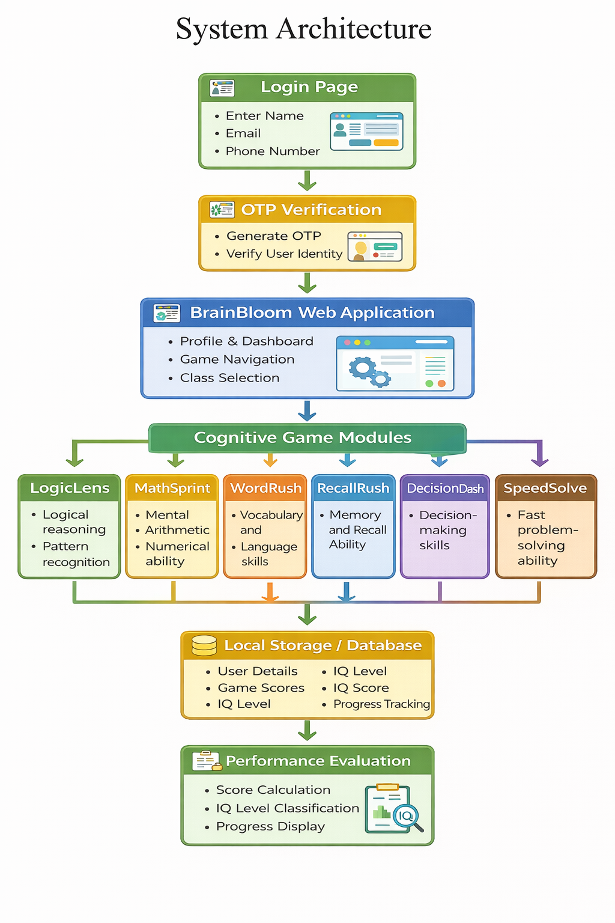

Slide 7
Project Modules
Module 1: Login & Authentication
Allows users to enter their name, email, and phone number.
Generates and verifies OTP for secure login.
Ensures that only authenticated users can access the system.
Module 2: User Profile
Displays user information such as name, email, and phone number.
Shows IQ level and user streak progress.
Provides personalized access to the BrainBloom dashboard.

Slide 8
Module 3:Game
Contains six cognitive games designed to improve thinking skills.
Games included: LogicLens, MathSprint, WordRush, RecallRush, DecisionDash, and SpeedSolve.
Each game focuses on developing different cognitive abilities.
Module 4: Quiz & Interaction
Displays questions based on the selected class and category.
Allows users to select answers and interact with the game interface.
Manages the flow of questions and user responses.

Slide 9
Module 5: Score Evaluation
Calculates scores based on user performance in games.
Evaluates cognitive ability using an IQ-based scoring system.
Categorizes users into levels like Foundation, Improving, Proficient, Advanced, and Excellent.
Module 6: Progress Tracking
Stores user details, scores, and progress using local storage.
Helps users track their improvement over time.
Displays overall performance and learning progress.

Slide 10
Objectives
To develop a web-based educational framework that helps students improve their cognitive skills through interactive activities.
To provide engaging cognitive games that enhance logical reasoning, memory, vocabulary, decision-making and problem-solving abilities.
To design a system that adjusts the difficulty level based on the student’s class
(6 to 10) for effective learning.
To implement an IQ-based scoring system that evaluates student performance and cognitive development.
To encourage students to practice regularly through gamified learning methods.
To help students track their progress and identify areas of improvement.
To create a simple, user-friendly interface that makes learning enjoyable and interactive.

Slide 11
Co’s Attainments - DSA
CO1 – Algorithm Analysis & Searching/Sorting
Implemented searching mechanisms for retrieving quiz questions based on class and category.
Applied algorithmic thinking and running time considerations while designing quiz evaluation logic.
Structured the question database to allow efficient retrieval similar to searching techniques.
Sorting concepts were studied and understood for organizing data structures.
CO2 – Lists and Linked List Concepts
Used dynamic data structures like ArrayList to store and manage quiz questions.
Demonstrated understanding of List ADT concepts through dynamic question storage.
Implemented operations such as insertion, retrieval, and iteration of elements in question lists.
Applied list-based structures to handle multiple categories of questions for each class level

Slide 12
CO3 – Stacks and Queues
Implemented sequential processing of quiz questions, similar to queue-based processing.
Demonstrated understanding of data flow and element handling through controlled question iteration.
Used structured programming logic that reflects concepts of ordered data access and processing.
CO4 – Hashing and Tree-Based Data Structures
Implemented HashMap-based hierarchical data storage for organizing quiz questions.
Used nested HashMaps to map Class → Category → Question List efficiently.
Demonstrated efficient data retrieval similar to hash-based lookup techniques.
Applied hashing concepts for fast question retrieval and structured data management.

Slide 13
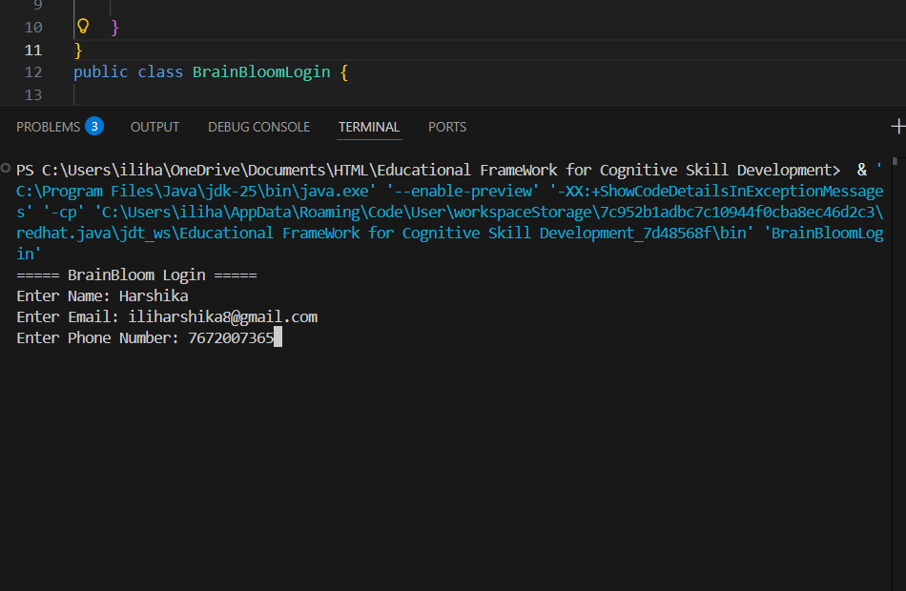
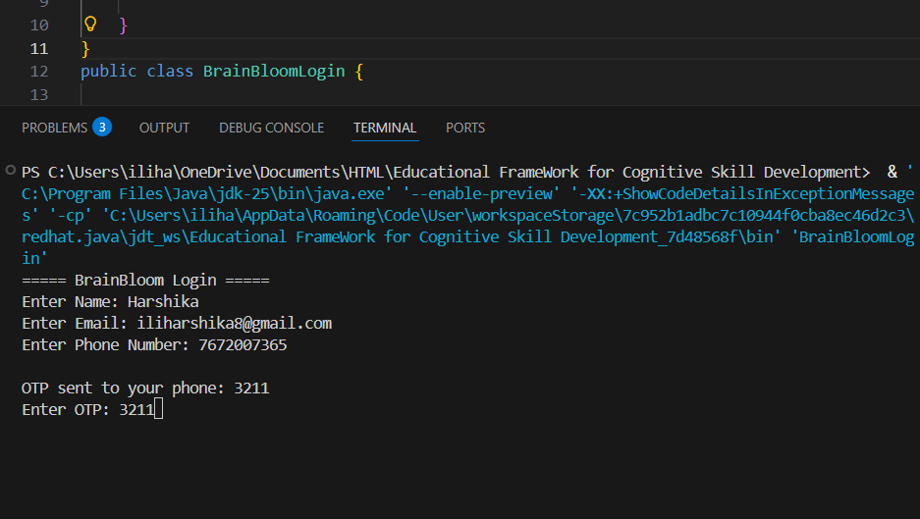
Screenshots for DSA

Slide 14
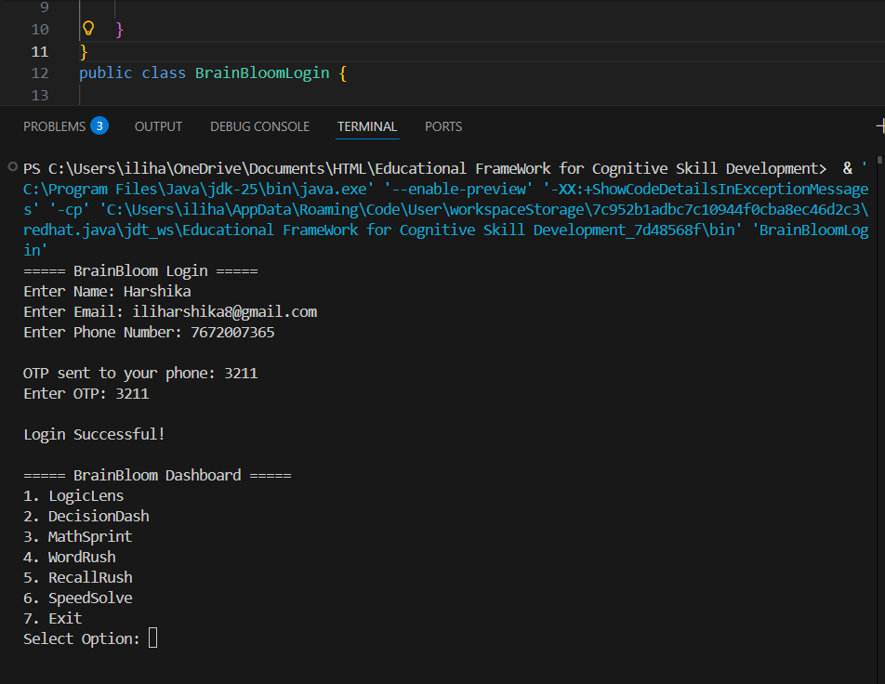
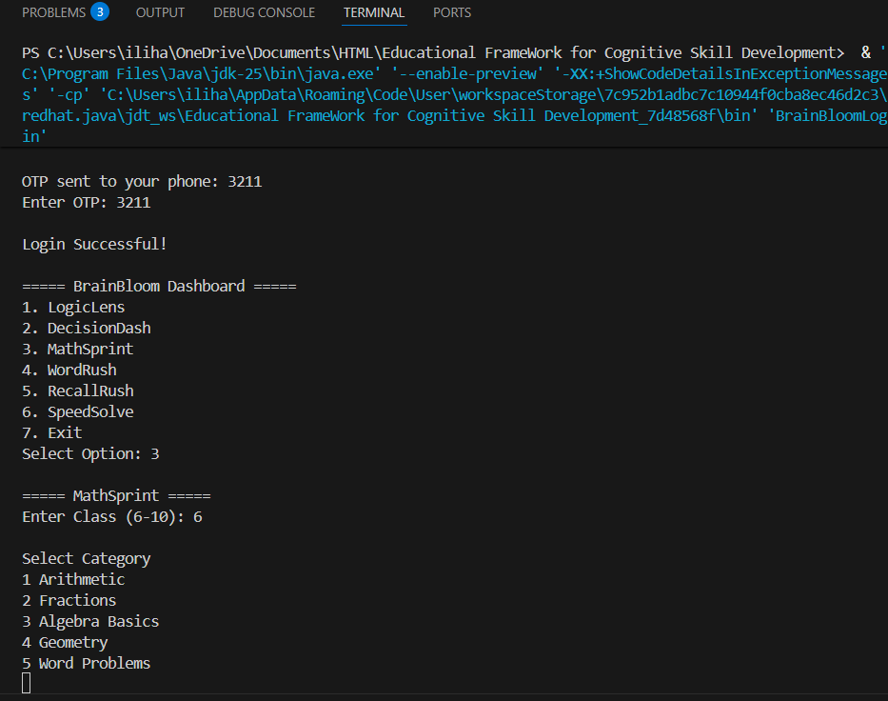

Slide 15
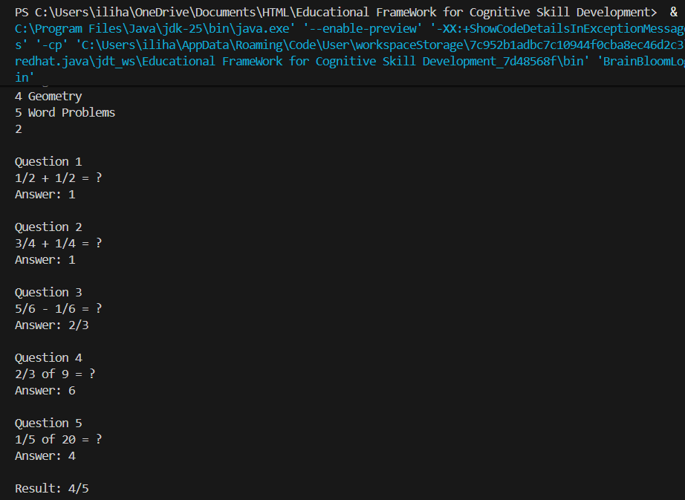
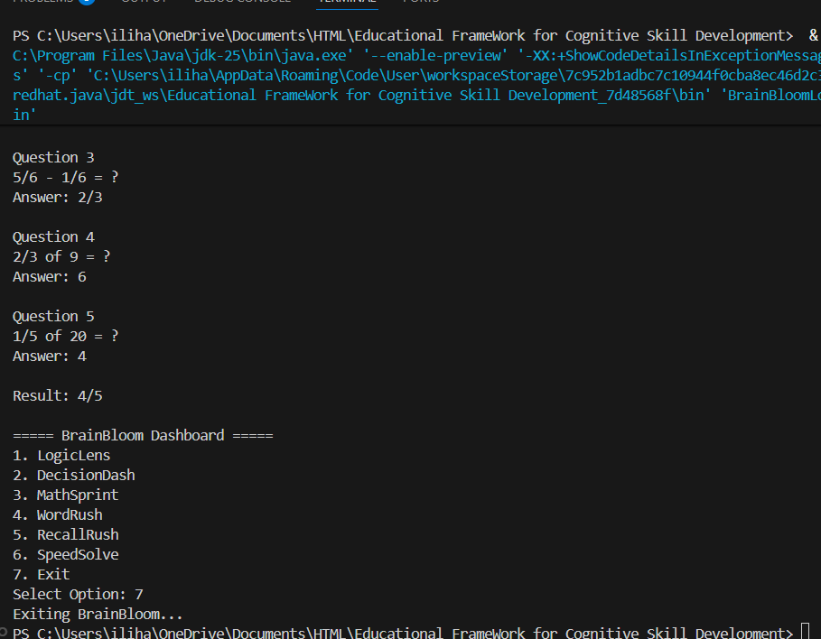

Slide 16
Conclusion
BrainBloom is a web-based educational framework designed to enhance cognitive skills among students from classes 6 to 10 through interactive learning.
The application includes features such as user login, OTP verification, a main dashboard, and class-based question levels to provide a structured learning environment.
An IQ-based scoring system evaluates student performance and categorizes learners into different cognitive levels.
The project demonstrates the effective use of HTML, CSS, and JavaScript in developing an interactive and engaging educational platform.
Overall, BrainBloom helps students practice regularly, track their progress, and improve their thinking abilities through gamified learning.

Slide 17
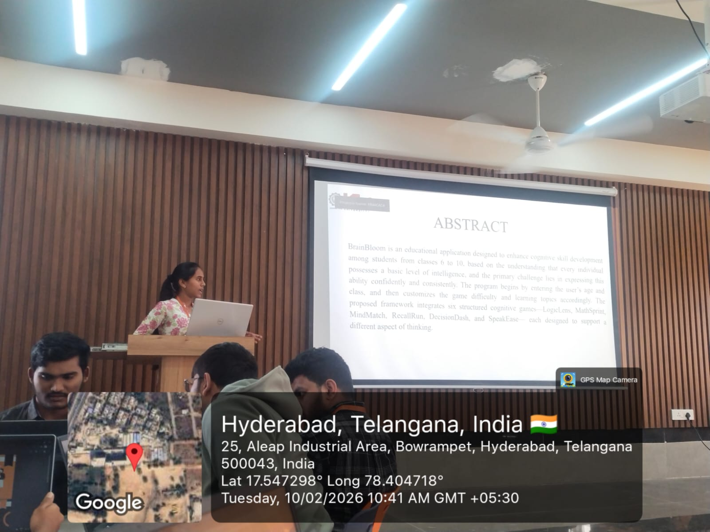
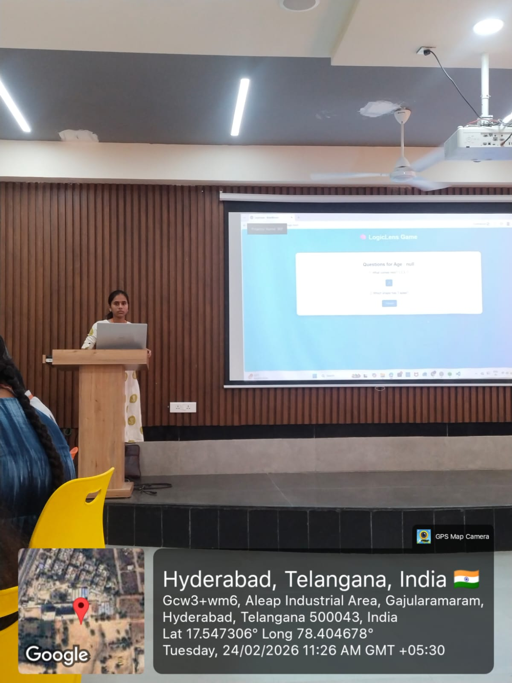
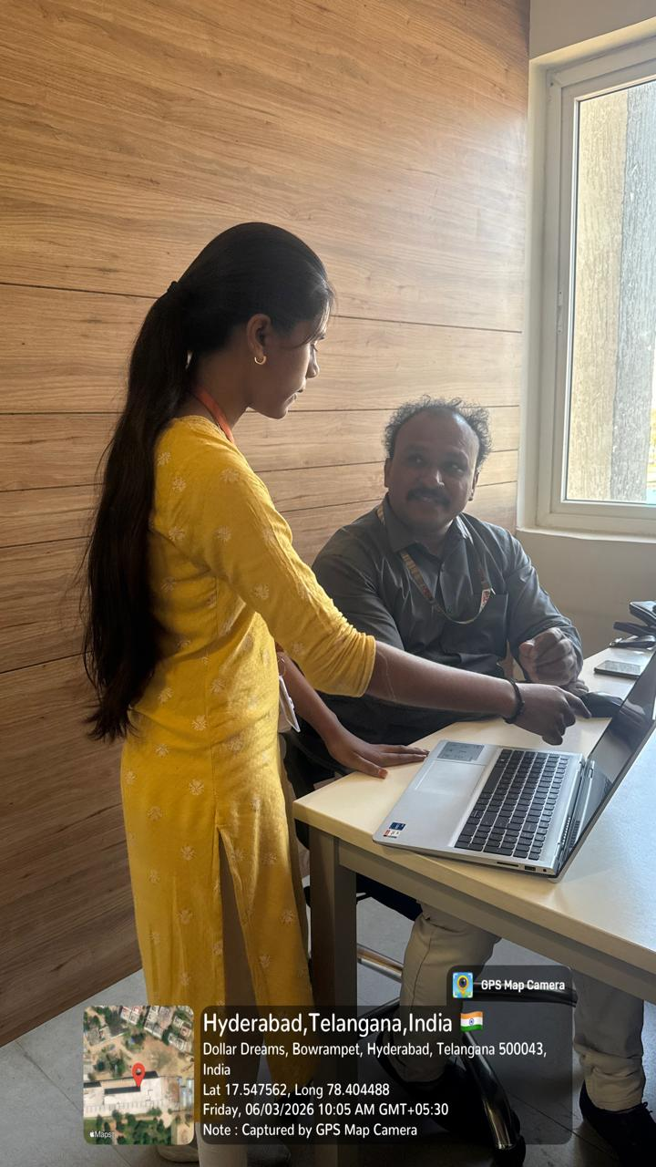
Geo- Tag Photos

Slide 18
THANK YOU

